Slide 1





Movies:
What factors affect their success?
Group- 9
David Kramer, Mojtaba Zadaskar, Yalda Alemi and Deepika Mehanti

Slide 2
The dataset: 2017 - 2022
Evaluated data from The Movie Database (TMBD), Open Movie Databse (OMDB) and TVMaze was evaluated.
The data was sourced from The Movie Database (TMDB) using their API (https://www.themoviedb.org/).
The data consists of all movies with budget data in the years 2017-2022. The complete data set has 15 columns and 15574 rows.
The fields collected are as follows:
TMDB ID
Original Title
Overview
Popularity
Release Date
Title
Vote Average
Vote Count
Budget
Revenue
Country
Original Language
Genre
IMDB ID

Slide 3
Initial Questions
Does budget affect popularity?
Does the Country of Origin affect popularity? Does Language?
Does director or cast affect the popularity?
Which countries produce the most content?
Which genre produces the most popular shows?
Is there a difference in what/how much is produced pre & post Covid?

Slide 4
How is popularity calculated?
Number of votes for the day
Number of views for the day
Number of users who marked it as a "favourite" for the day
Number of users who added it to their "watchlist" for the day
Release date
Number of total votes
Previous days score

Slide 5
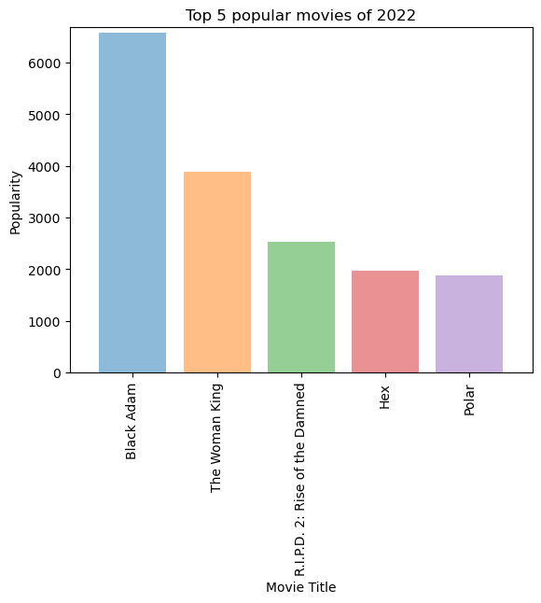
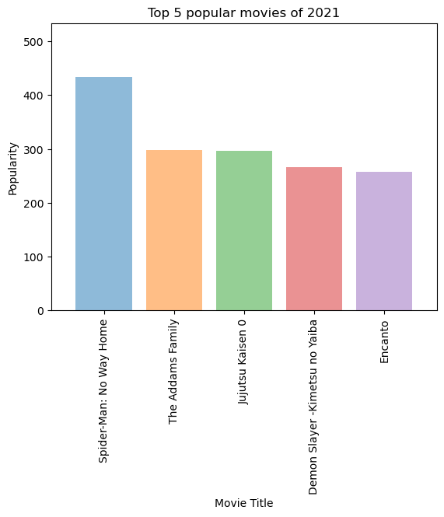
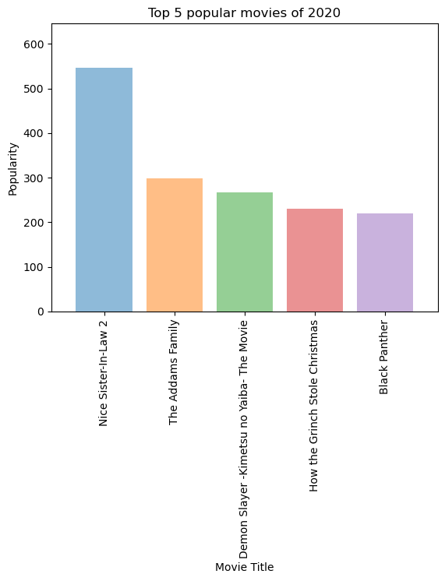
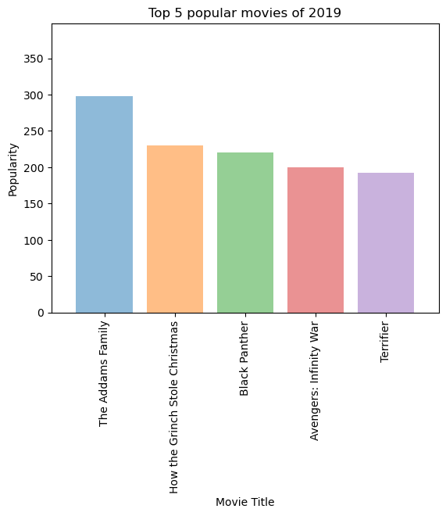
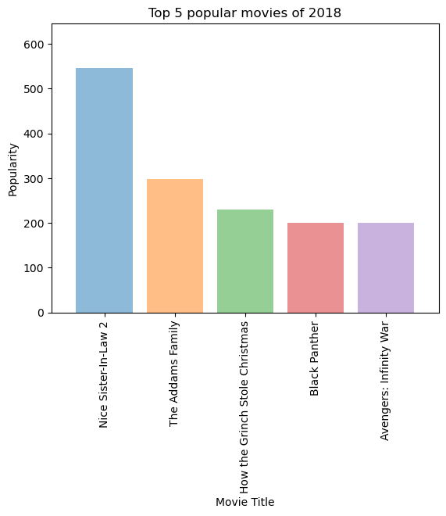
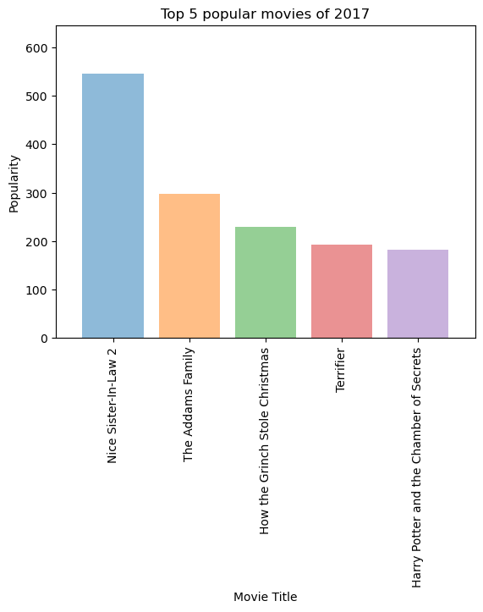
Top 5 Popular Movies
2017-2022
Movies which are consistently in Top 5 .
The Adams family 2017-2021.
How the Grinch stole Christmas 2017-2020.
Black Panther 2018-2020
Black Adam is leading in year 2022.

Slide 6
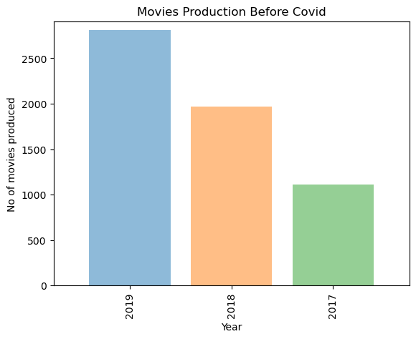
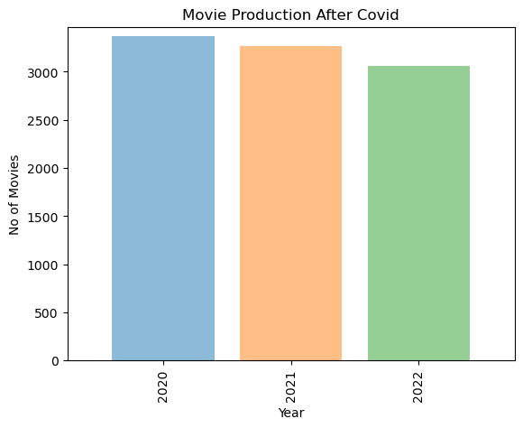
Movies Produced Before and After Covid-19
Movies Produced Before Covid -19
From Year 2020-2022
Movies Produced After Covid -19
From Year 2020-2022

Slide 7
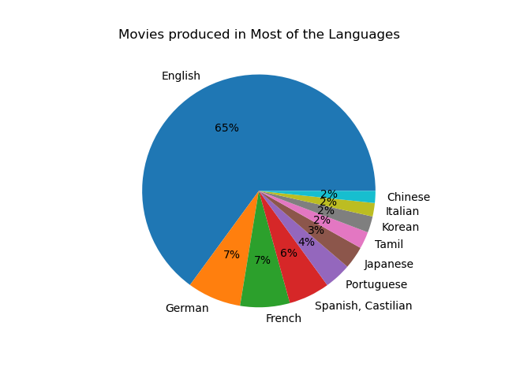

Movies Produced in Most Languages.
English
German
French
Spanish
Portuguese
Tamil
Korean
Italian
Chinese

Slide 8
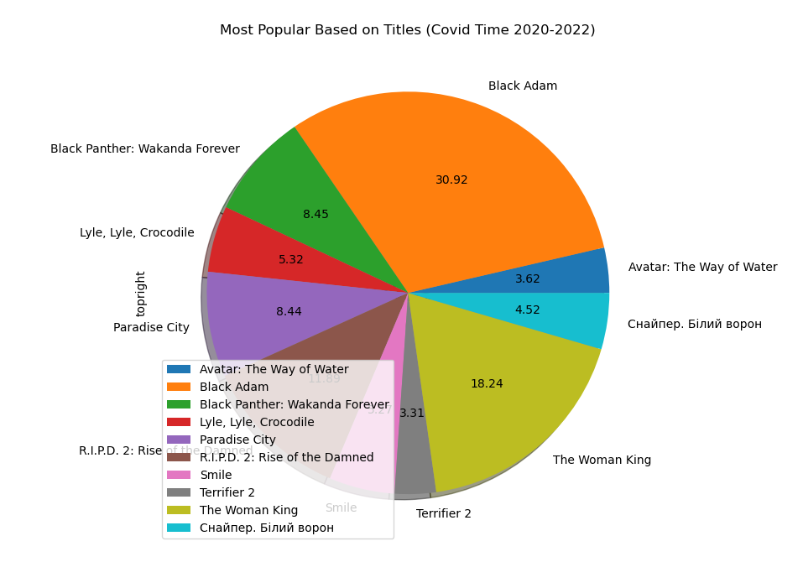
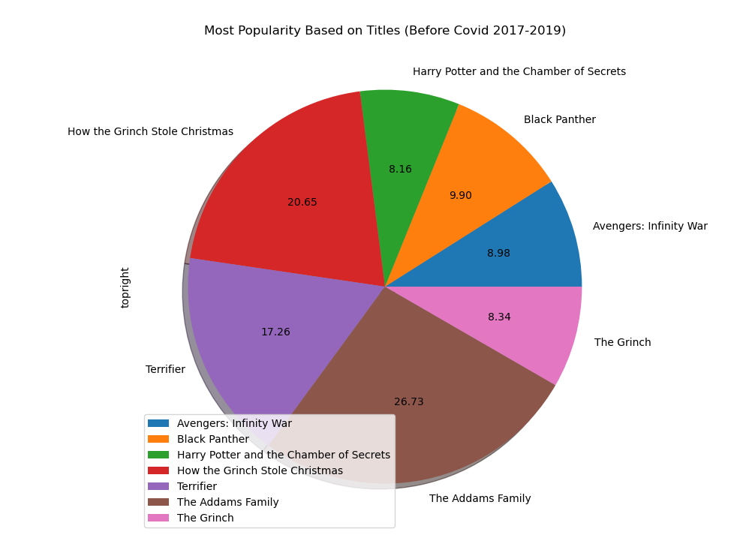
Comparison of Most popular Movie during Covid(2020-2022) with Pre- Covid(2017-2019)

Slide 9
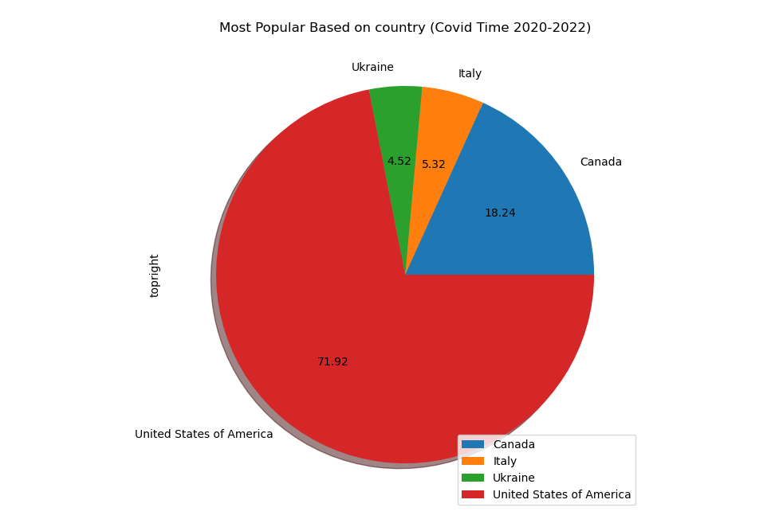
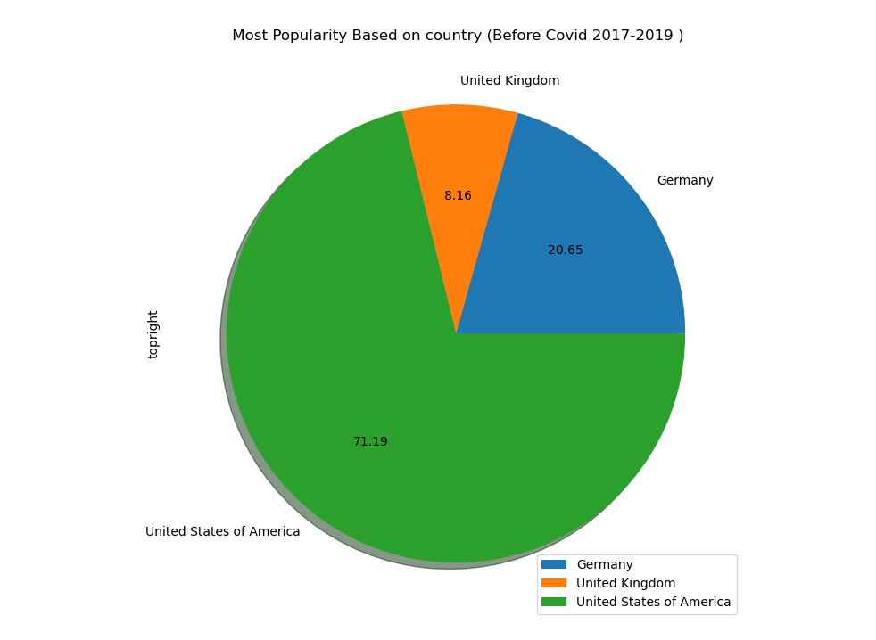
Comparison of Most popular Movie during Covid(2020-2022) with Pre- Covid(2017-2019) based on the origin Country

Slide 10
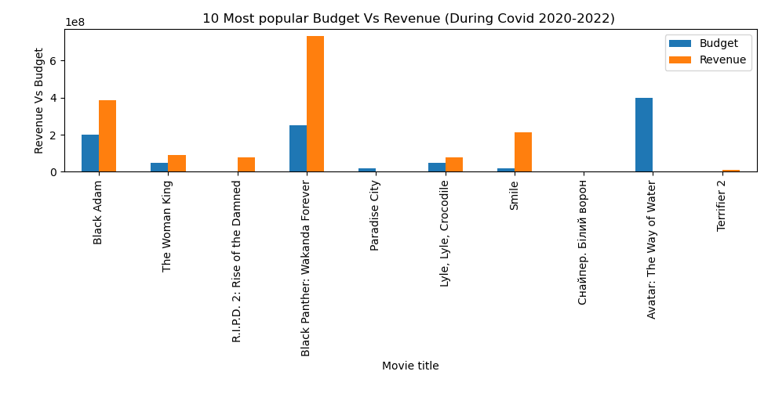
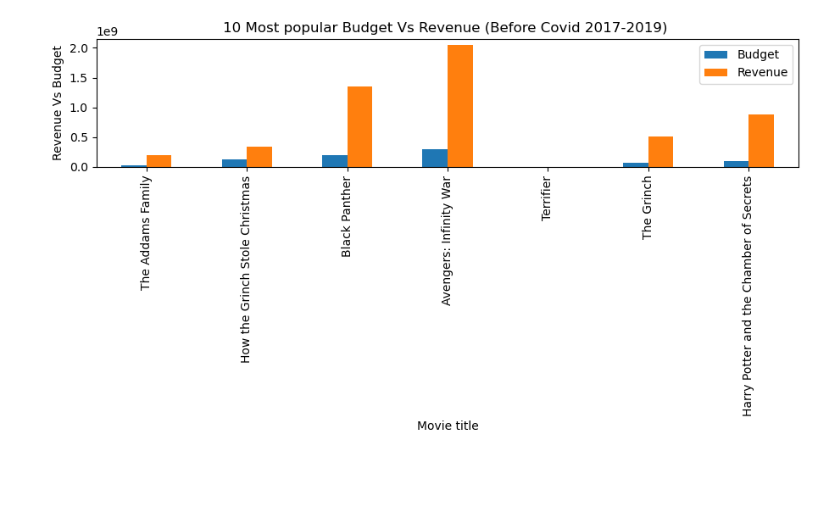
Comparison of Most popular Movie during Covid(2020-2022) with Pre- Covid(2017-2019) based on the Budget and Revenue

Slide 11
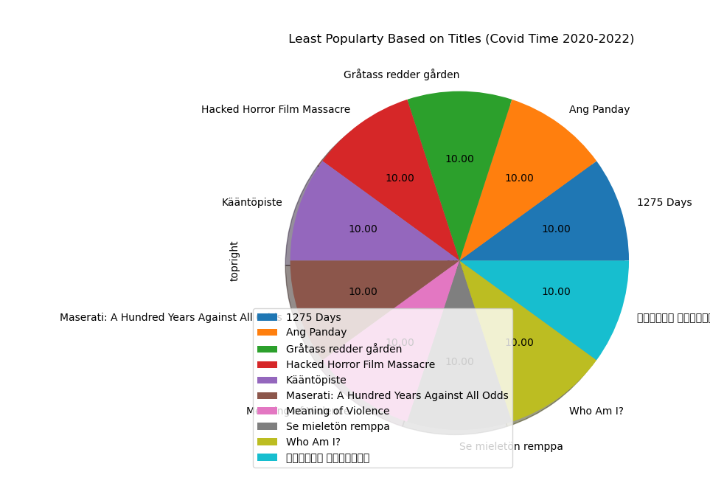
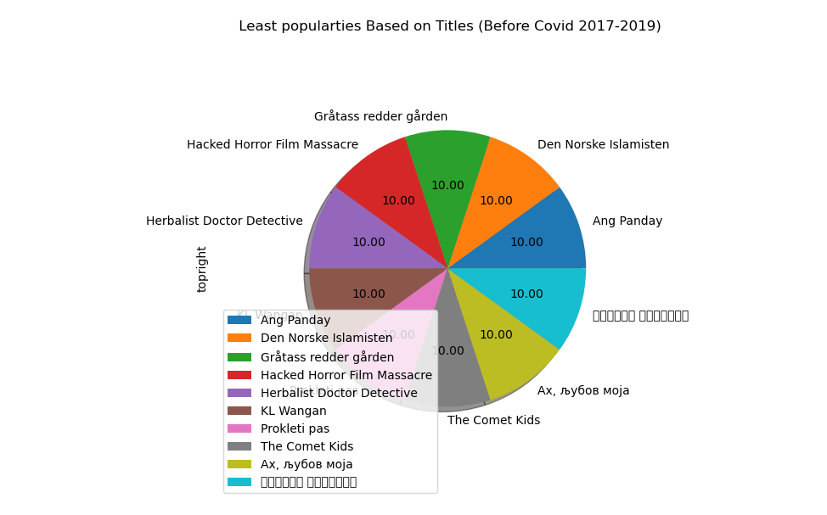
Comparison of Least popular Movie during Covid(2020-2022) with Pre- Covid(2017-2019)

Slide 12
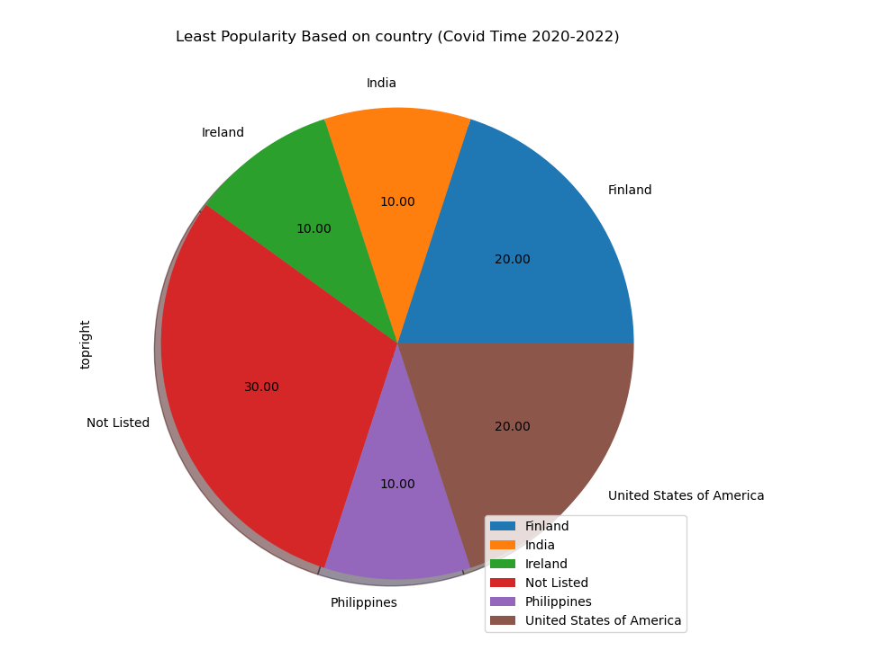
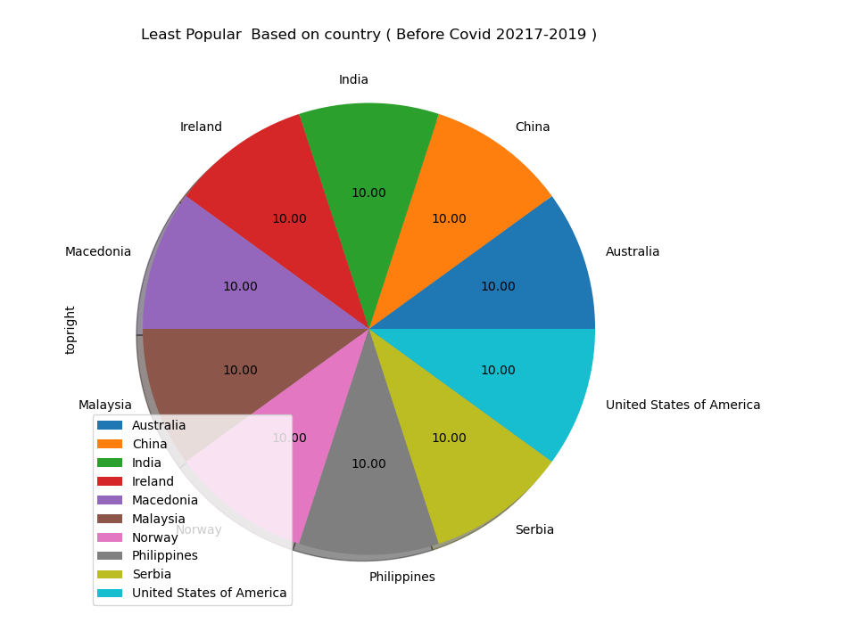
Comparison of Least popular Movie during Covid(2020-2022) with Pre- Covid(2017-2019) based on the origin Country

Slide 13
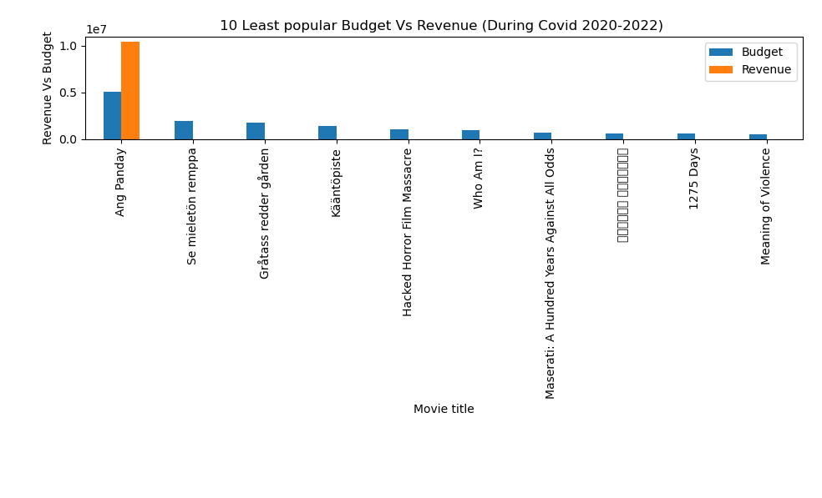
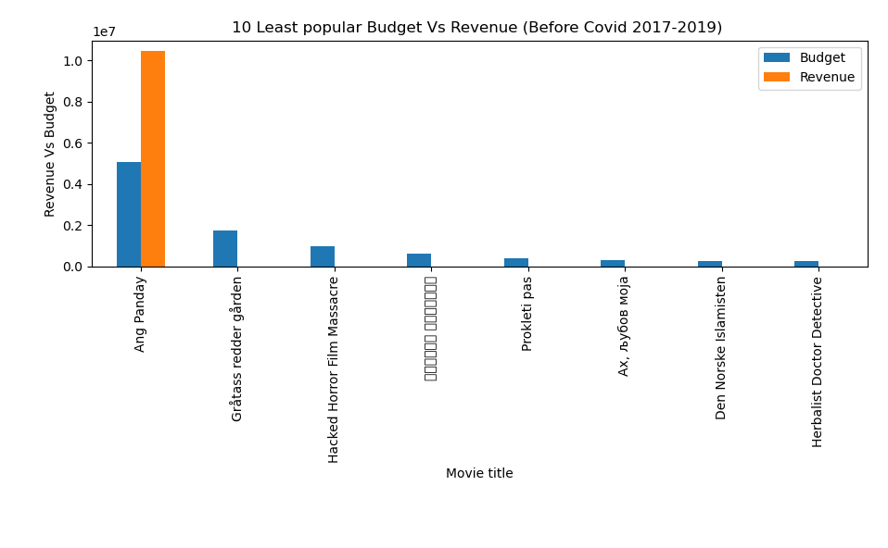
Comparison of Least popular Movie during Covid(2020-2022) with Pre- Covid(2017-2019) based on the Budget and Revenue

Slide 14
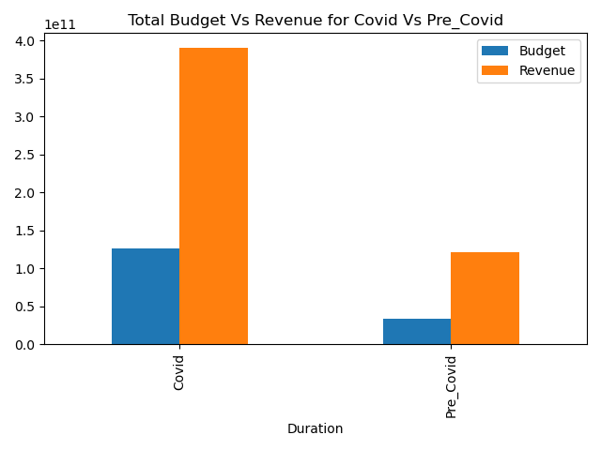
World Budget Vs Revenue for Covid Vs Pre Covid
number of movie released before Covid based on TMDB : 3077
number of movie released during Covid based on TMDB : 9690
 | Budget | Revenue
Duration
Covid | $125,645,049,257 | $390,295,360,771
Pre_Covid | $33,847,325,827 | $120,838,297,79

Slide 15
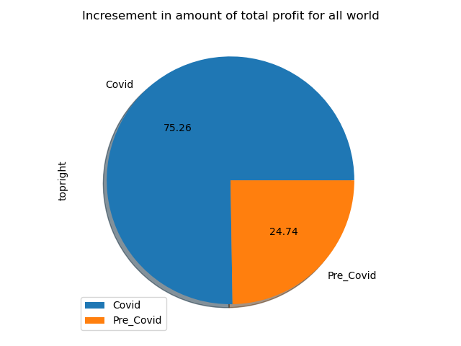
World profit Increasement Percentage

Slide 16
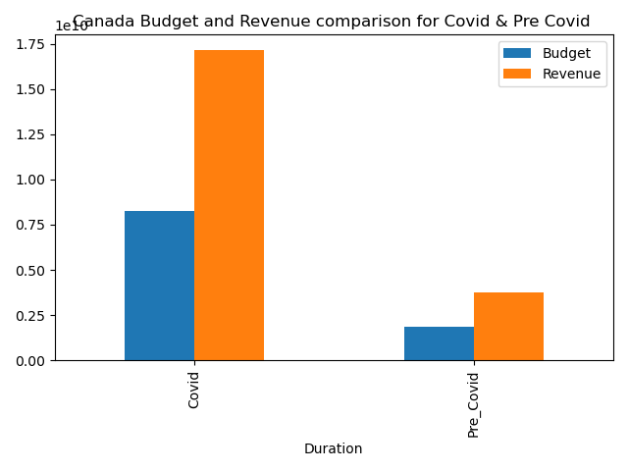
World Budget Vs Revenue for Covid Vs Pre Covid
 | Budget | Revenue
Duration
Covid | $ 8,277,610,000 | $ 17,150,630,000
Pre_Covid | $ 1,860,853,000 | $ 3,762,185,000

Slide 17



Movie Suggestion
Release Date:16 –Dec -2022
R.I.P.D.2:Rise of the Damned
Name: Sniper.White Raven (Ukranian)
Release Date: Aug 24 2022

Slide 18
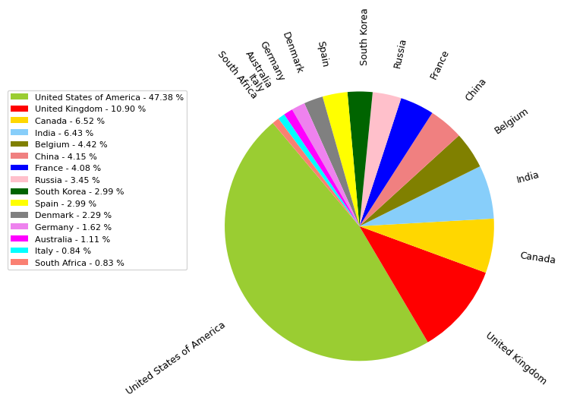
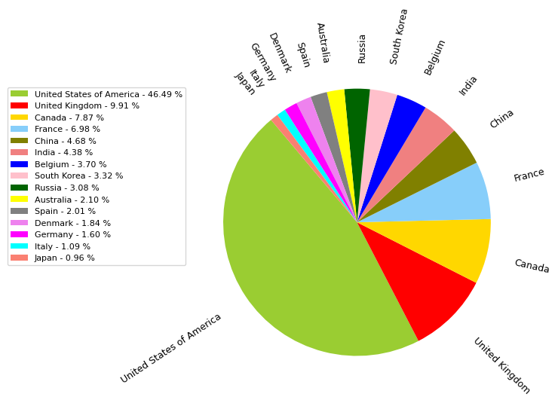
Popularity vs Country – Pre-covid vs After Covid
Pre-covid
After Covid

Slide 19
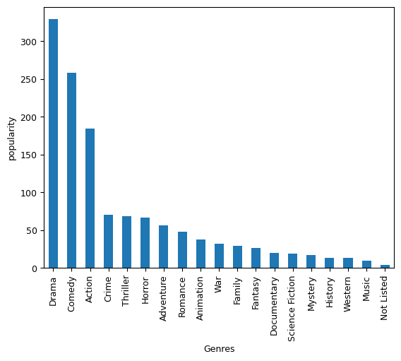
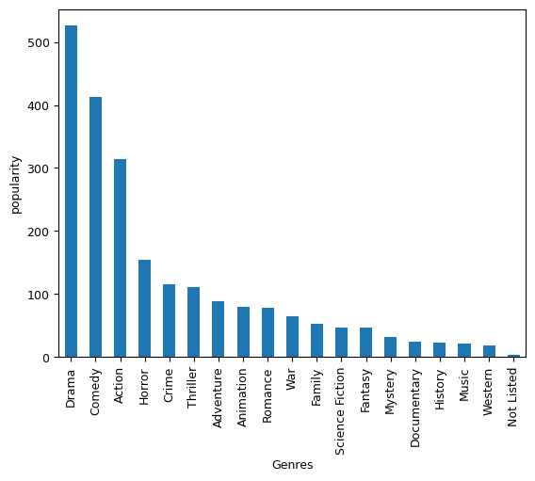
Popularity vs Genre - Pre-covid vs After Covid
Pre-covid
After Covid

Slide 20
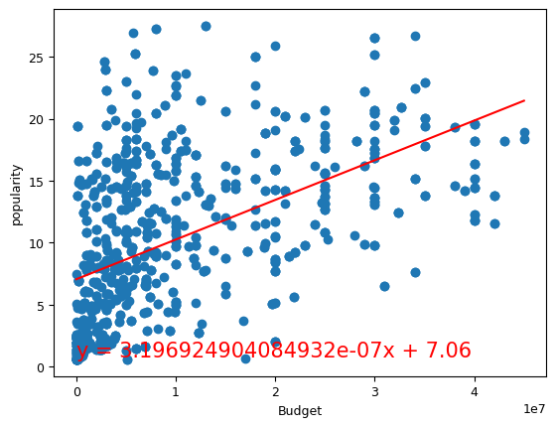
Popularity vs Budget - Precovid
The correlation between both factors is 0.52
The r-squared is: 0.2668004891145089

Slide 21
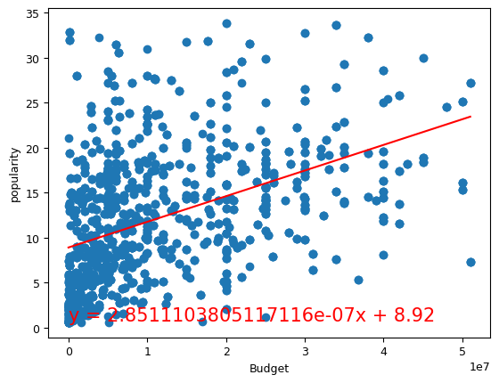
Popularity vs Budget - Covid
The correlation between both factors is 0.44
The r-squared is: 0.1972348316534791

Slide 22
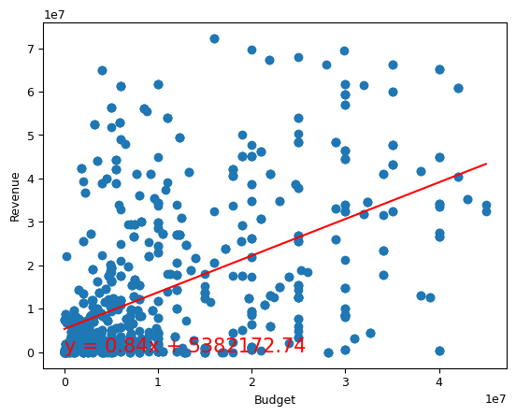
Revenue vs Budget - Precovid
The correlation between both factors is 0.53
The r-squared is: 0.28174111564286397

Slide 23
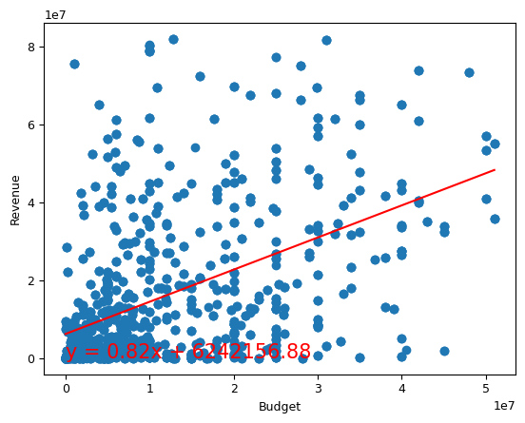
Revenue vs Budget - Covid
The correlation between both factors is 0.49
The r-squared is: 0.24269861129236264

